Slide 1
Intel Image Classification
DTSA5511 - Introduction to Deep Learning Final Project

Slide 2
Agenda
Project Overview
Dataset Exploration
Data Augmentation
Model Architectures
Training Process
Results!
Conclusion & Future Work

Slide 3
Project Overview
Project Overview: Explored various deep learning models (CNN, ViT, GCN) to classify images from the Intel Image Classification dataset into different scenes (buildings, forests, glaciers, mountains, sea, and street).
AMA Citation: PuneetGupta25. Intel Image Classification. Kaggle website. https://www.kaggle.com/datasets/puneet6060/intel-image-classification. Accessed August 15, 2024.
Objective: To compare the performance of different neural network architectures and identify the best approach for accurately classifying scenes.
Scope: Implemented and trained multiple models, conducted hyperparameter tuning, and evaluated performance metrics across architectures.

Slide 4
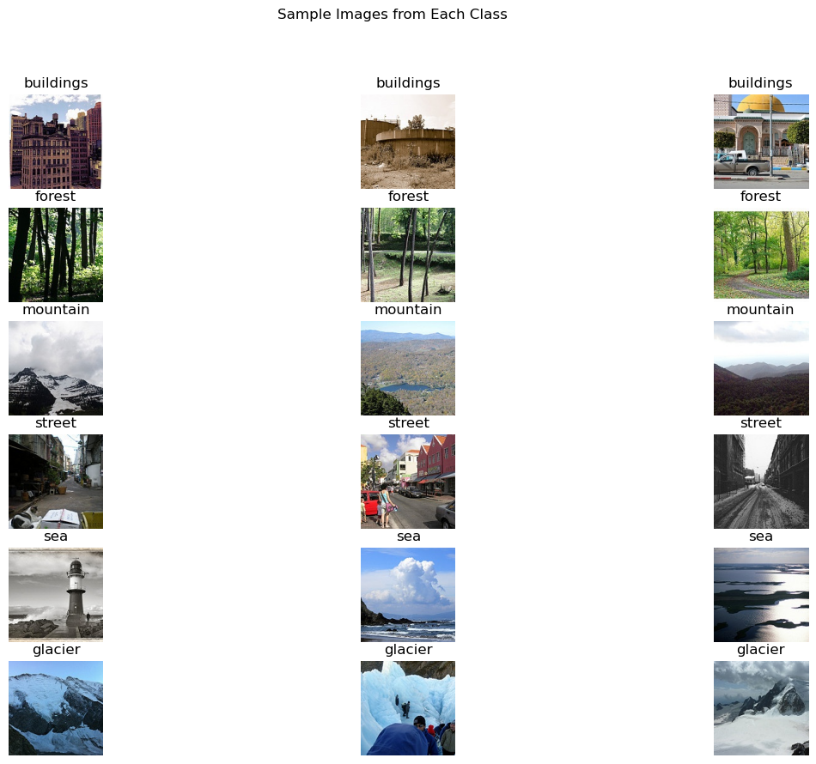
Data Exploration
Overview: The dataset consists of images categorized into six different scene types: buildings, forests, glaciers, mountains, sea, and streets.
Visual Content: Display sample images from each category to give an overview of the visual diversity in the dataset.
Purpose: To provide a clear understanding of the types of scenes that the models are trained to classify.
Key Point: The images vary in complexity, lighting, and composition, which poses a challenge for accurate classification.

Slide 5
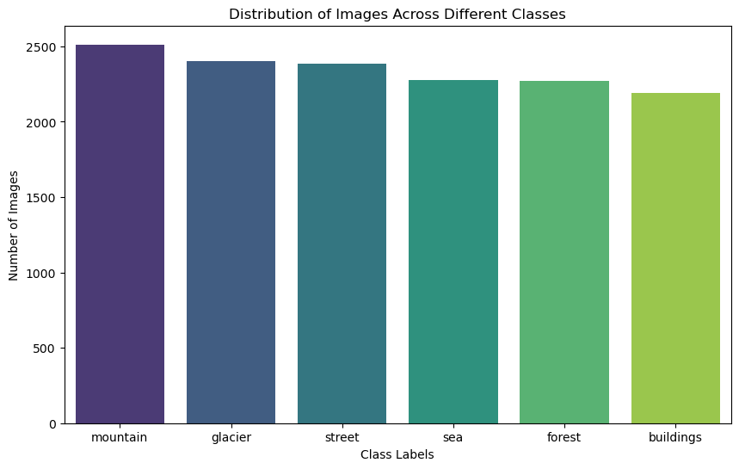
Data Exploration
Overview: The dataset is well-balanced across the six categories.
Visual Content: Include a bar plot showing the number of images in each class to demonstrate class distribution.
Purpose: Highlight that there are no significant imbalances in the dataset, ensuring that the model does not favor any particular class during training.
Key Point: The balanced distribution ensures that each scene type is represented fairly, reducing bias in model predictions.

Slide 6
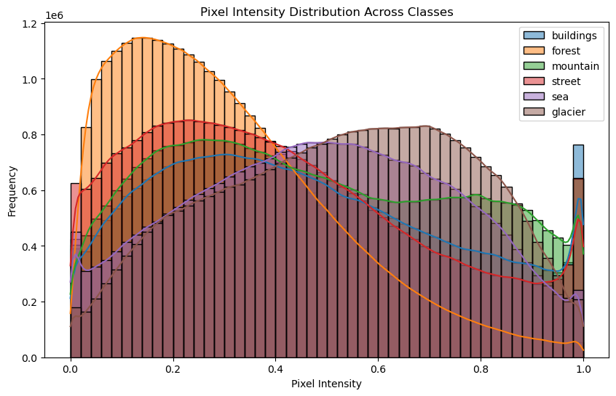
Data Exploration
Overview: Analyzed the pixel intensity distribution across different scene categories.
Visual Content: Display histograms of pixel intensity for each class, showing how pixel values are distributed.
Purpose: Illustrate the variance in brightness and contrast within the dataset, and identify any trends in pixel value distribution across scene types.
Key Point: The pixel intensity distributions vary across classes, informing the need for normalization and preprocessing techniques before training.

Slide 7
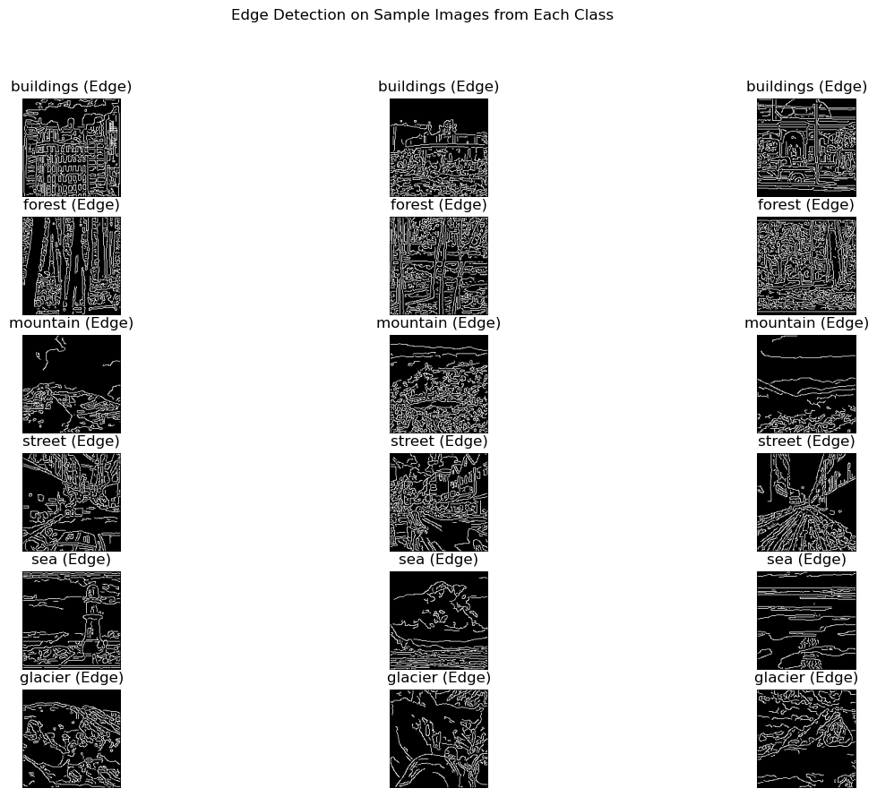
Data Exploration
Overview: Applied Canny edge detection to a subset of images from the dataset.
Visual Content: Display edge-detected images for different scenes, such as buildings, forests, glaciers, etc.
Purpose: Show how edge detection highlights the structural features in the images, which could be leveraged to improve classification accuracy.
Key Point: Edge detection captures important structural details that may help the model differentiate between visually similar scenes.

Slide 8
Data Augmentation & Normalization
Training Data Augmentation
Random Horizontal Flip: Randomly flips the image horizontally, helping the model generalize better by simulating different orientations of the same scene.
Random Rotation: Randomly rotates the image by up to 15 degrees, introducing variability in the angle of view for the model to handle.
Color Jitter: Adjusts the brightness, contrast, saturation, and hue of the image, mimicking different lighting conditions to make the model more robust to color variations in the scenes.
Random Resized Crop: Randomly crops a portion of the image (between 80% to 100% of its original size) and resizes it to 128x128 pixels, allowing the model to focus on different parts of the image during training.

Slide 9
Data Augmentation & Normalization
Normalization
Purpose: Standardizes pixel intensity values across all images, ensuring that each pixel value falls within a consistent range, regardless of the original lighting or color conditions.
Mean and Standard Deviation:
Mean: [0.485, 0.456, 0.406]
Standard Deviation: [0.229, 0.224, 0.225]
Training and Testing Consistency: Both the training and testing datasets are normalized using the same mean and standard deviation values, which are derived from the ImageNet dataset. This allows for consistent preprocessing across all images.
Notes:
Impact
Augmentation: Data augmentation strategies increase the diversity of the training data, which helps to prevent overfitting and allows the model to generalize better to unseen data.
Normalization: Ensures that the model converges faster and more stably during training by standardizing the input values.

Slide 10
Model Architectures
Model Type | Characteristics | Strengths | Weaknesses
SimpleCNN (SCNN) | - Shallow CNN with 3 convolutional layers, ReLU activations, max-pooling, and dropout. - Fully connected layer with 512 neurons before output. | - Simple and efficient. - Quick training and good baseline performance. | - Limited feature extraction due to shallow architecture. - Prone to overfitting on complex datasets.
AdvancedCNN (ACNN) | - Deeper CNN with 4 convolutional blocks. - Batch normalization in each block. - Max pooling and dropout layers. - Fully connected layers for classification. | - Deeper architecture captures more complex features. - Batch normalization improves training stability. | - Computationally intensive vs SCNN - Risk of overfitting if the dataset is too small.
Vision Transformer (ViT) | - Splits image into patches and uses self-attention to model relationships between patches. - Position embedding for spatial information. | - Models long-range dependencies in images. - Effective when trained on large datasets. - Suitable for complex, global patterns. | - Struggles with small datasets. - Computationally expensive. - Underperforms on small-scale tasks.
Graph Convolutional Network (GCN) | - Treats each pixel as a node in a graph. - Edges represent spatial proximity. - Graph convolutions aggregate neighboring pixel features. - | - Leverages spatial relationships between pixels. - Useful for datasets with relational data. - Provides a novel approach to image classification. | - Complexity of graph representation can hinder performance. - Slower training compared to CNNs. - Lower accuracy on non-relational image data.

Slide 11
Training Process
Training Process: Hyperparameter Search
Objective: Fine-tune the model architectures by searching for the optimal hyperparameters to maximize accuracy on the image classification task.
Hyperparameter Search Space
Batch Size: The batch sizes tested varied between 32 and 64. Larger batch sizes allowed for faster training by processing more data at once, while smaller batch sizes potentially improved generalization by adding more noise to the gradient updates.
Dropout Rate: I explored dropout rates of 0.3 and 0.5 cross both CNN models to mitigate overfitting by randomly dropping neurons during training, improving model generalization.
Learning Rate: Learning rates varied from 0.0001 for the deeper AdvancedCNN to 0.001 for other models like the SimpleCNN and ViT. Smaller learning rates enabled finer adjustments to model weights, while larger learning rates led to faster convergence at the risk of missing the optimal solution.
Optimizer: The Adam optimizer was used across all models due to its adaptive learning rate capabilities, which adjusted learning rates based on the magnitude of past gradients, resulting in faster and more stable convergence.

Slide 12
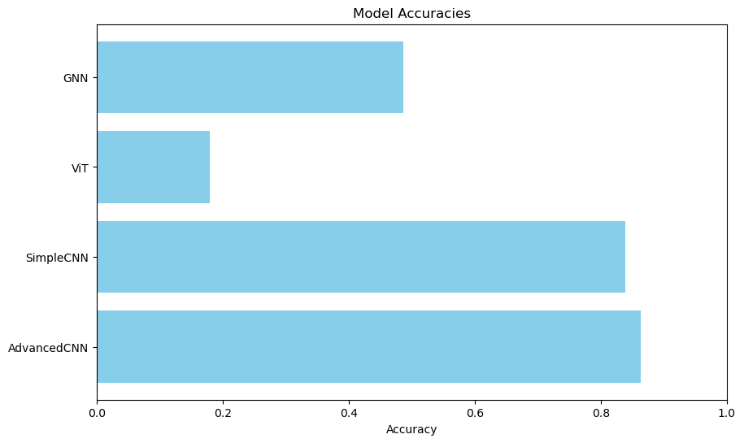
Results
Results
AdvancedCNN achieved the best performance with an accuracy of 86.3%, using a batch size of 64, a dropout rate of 0.3, and a learning rate of 0.0001.
SimpleCNN also performed well, reaching 83.9% accuracy with a similar batch size and dropout rate but with a learning rate of 0.001.
Vision Transformer (ViT) underperformed with an accuracy of 18%, likely due to its reliance on larger datasets and insufficient data for the task at hand.
Graph Convolutional Network (GCN) achieved a moderate accuracy of 48.7%, with its performance likely limited by the complexity of graph-based data representation for image classification.

Slide 13
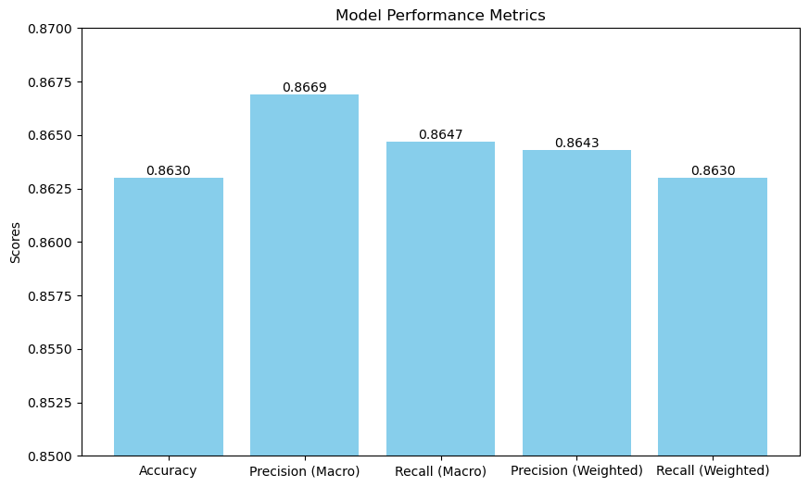
Results
The model achieved an accuracy of 86.3%, indicating its overall ability to correctly classify images across the test dataset.
Precision (Macro) scored slightly higher at 86.69%, reflecting the model's ability to correctly predict each class, averaged equally across all classes.
Recall (Macro) reached 86.47%, indicating the model's effectiveness in identifying all relevant instances for each class.
Precision (Weighted) and Recall (Weighted) were 86.43% and 86.30%, respectively, showing that these metrics, which consider the imbalance in class occurrences, closely align with the macro scores.

Slide 14
Conclusion & Future Work
Key Takeaway: Convolutional neural networks, especially deeper architectures like AdvancedCNN, excelled in this image classification task, while the transformer and graph-based approaches were less successful, indicating that data size and architecture choice significantly impact model performance.
Future Work
Dataset Expansion: Increasing the dataset size or using pre-trained transformers on larger datasets could improve the performance of the Vision Transformer (ViT).
Graph Convolutional Network (GCN) Enhancements: Experimenting with different graph structures or incorporating additional spatial/contextual data into the graph representation could boost GCN performance.
Advanced Optimization: Explore learning rate schedulers, weight decay adjustments, and alternative optimizers like AdamW or RMSprop to improve model convergence and generalization.
Ensemble Methods: Combine predictions from multiple models (e.g., CNNs, GCNs, ViTs) to potentially enhance overall accuracy by leveraging the strengths of each architecture.
Transformer Tuning: Fine-tune hyperparameters in transformer models, such as the number of attention heads and layer depth. Experiment with other attention mechanisms like Swin Transformer or hybrid architectures to enhance performance in future transformer-based approaches.

